Slide 1

PROJECT GUIDE-Rohit Sir & Rakesh Sir SUBMITTED BY- Kuljeet, Tarandeep & Lokesh
NETPLIX MOVIE APPLICATION
Get ready to be captivated, thrilled, and entertained. NetPlix – Where Entertainment Never Ends.

Slide 2


CONTENTS
INTRODUCTION
STATEMENT
APPROACH
MAIN FEATURES
FUNCTIONALITIES
TECHNOLOGY USED
ARCHITECTURE DIAGRAM
FLOW & CLASS DIAGRAM
FUTURE ENHANCEMENT
Final Output

Slide 3
INTRODUCTION
Discover Endless Entertainment with NetPlix
Welcome to the world of NetPlix, your ultimate destination for immersive entertainment. With our revolutionary movie application, you're in control of what you watch, when you watch it, and how you watch it.
Unlimited Choices
Original Content
Personalized Recommendations
Multiple Profiles

Slide 4
How we started working on Project
DATABASE
CODE
TEST
ARCHITECTURE DIAGRAM
Created a flow diagram to analyze and optimize the program flow
Create tables and insert data into it
Write the code as per the flow and added features
Verify the code manually and using test cases

Slide 5
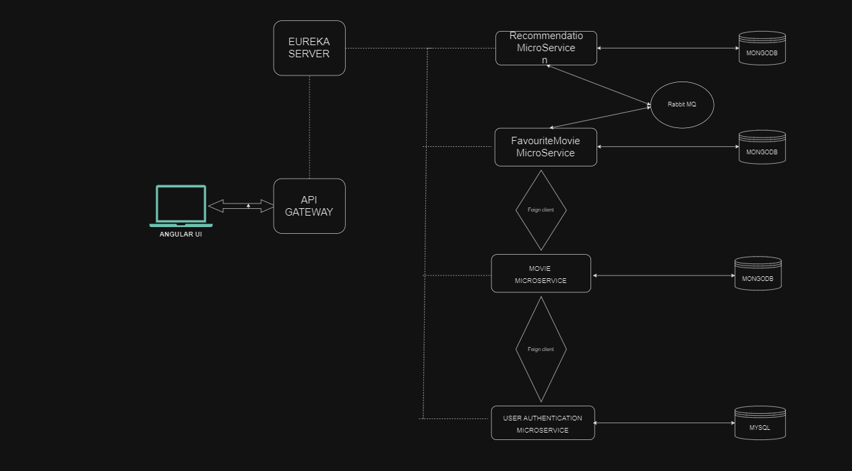
ARCHITECTURE DIAGRAM

Slide 6
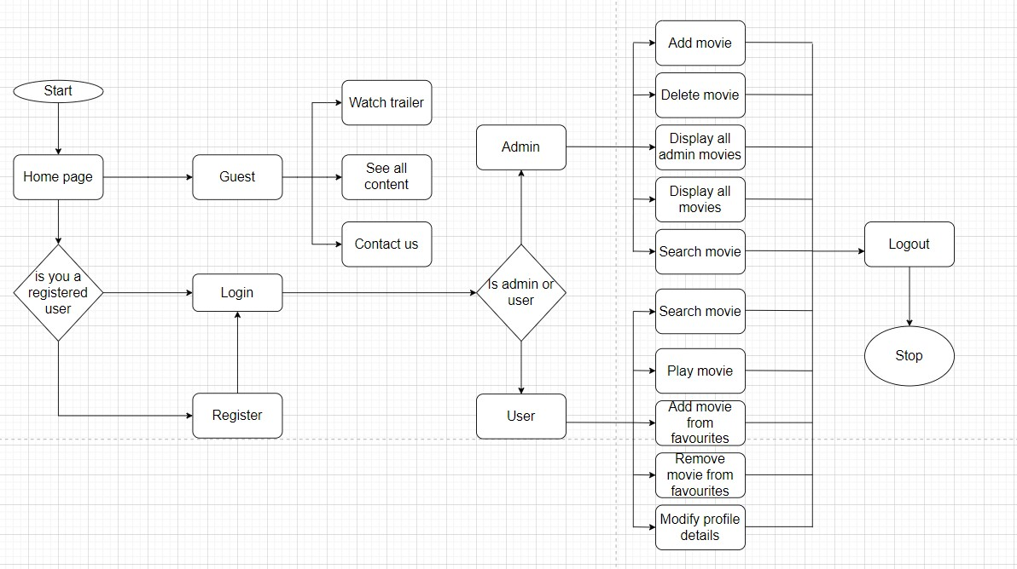
FLOW DIAGRAM

Slide 7
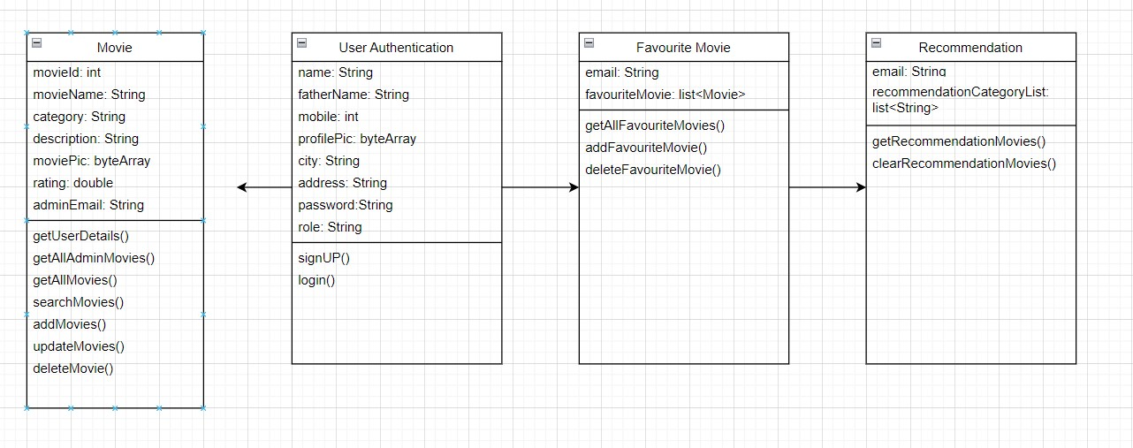
CLASS DIAGRAM

Slide 8


MAIN FEATURES
VIEW ALL MOVIES, TRENDING, NEW ADDED, THRILLER & many more
SEARCH MOVIE BY NAME
LOGIN & REGISTER
ADD TO FAVORITE BY USER
ADMIN - CREATE & MANAGE MOVIES

Slide 9


IMPLEMENTED FEATURES
User can register and login
User can search for a movie
User can view the recommended MOVIES
User can play the trailers and watch movies
User can view favourite movies
User can add/delete movies in the favourite list
User can watch/view trending, thriller, adventures new added Movies
JWT token for AUTHENTICATION
Secured API ENDPOINT by a token system
Synchronous & asynchronous communication
Testing by JUnit
Admin can view all the added movies, view users, update movie
API gateway used for managing, securing, and optimizing communication between client and backend.
Dockerize the application

Slide 10
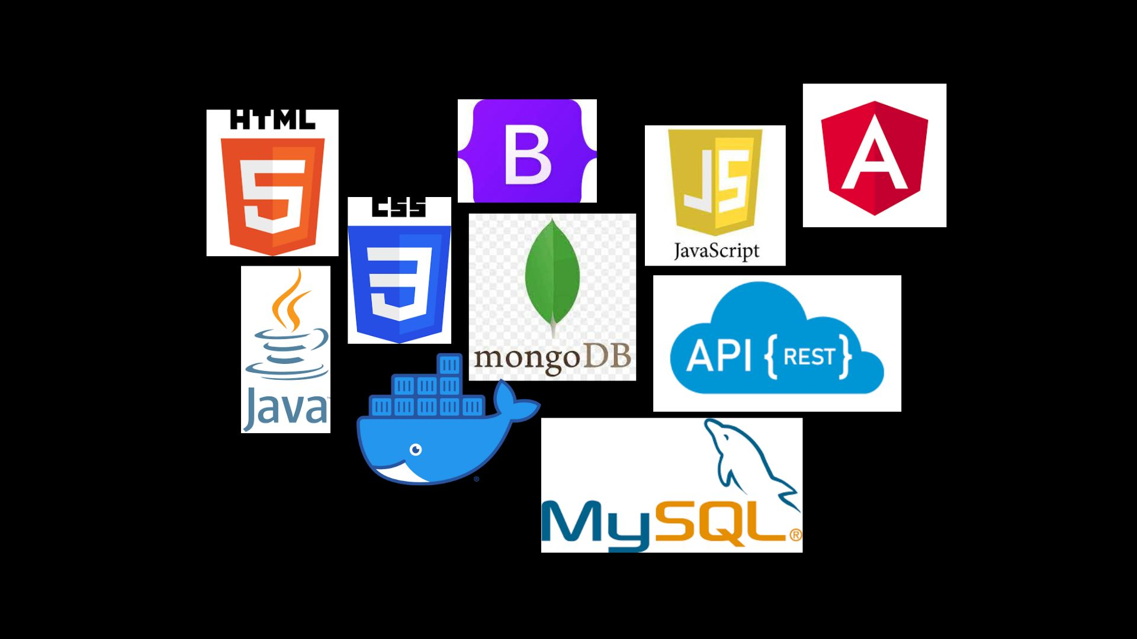
TECHNOLOGIES USED
Front end: Angular, HTML, CSS, TypeScript
Backend: JAVA, Spring Boot
Database: My SQL and MongoDB
Testing: Junit
SECURITY: JWT
APPLICATION: DOCKER & API

Slide 11
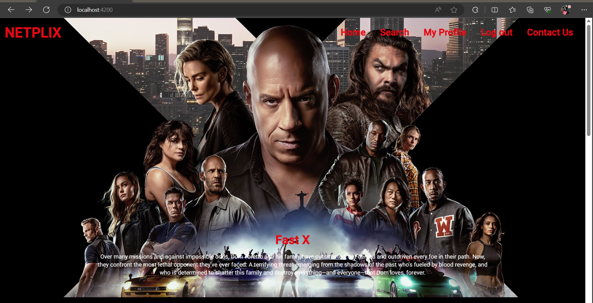
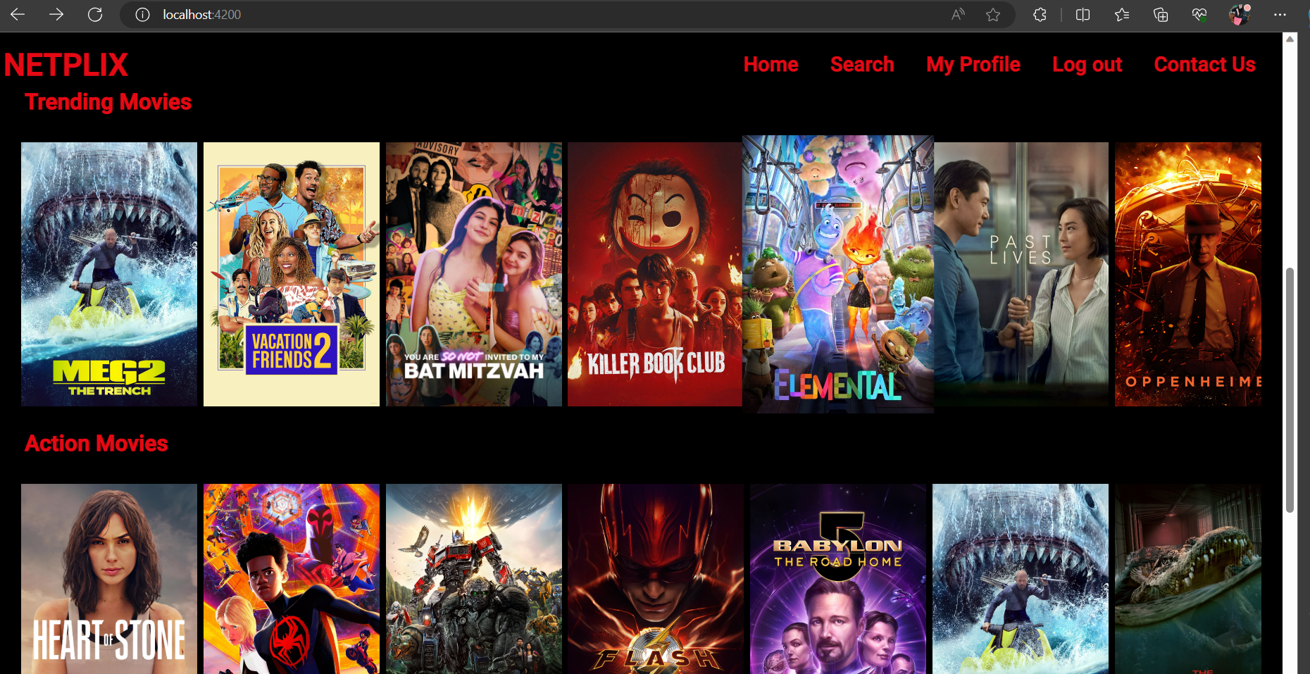
FINAL OUTPUT
HOME PAGE

Slide 12
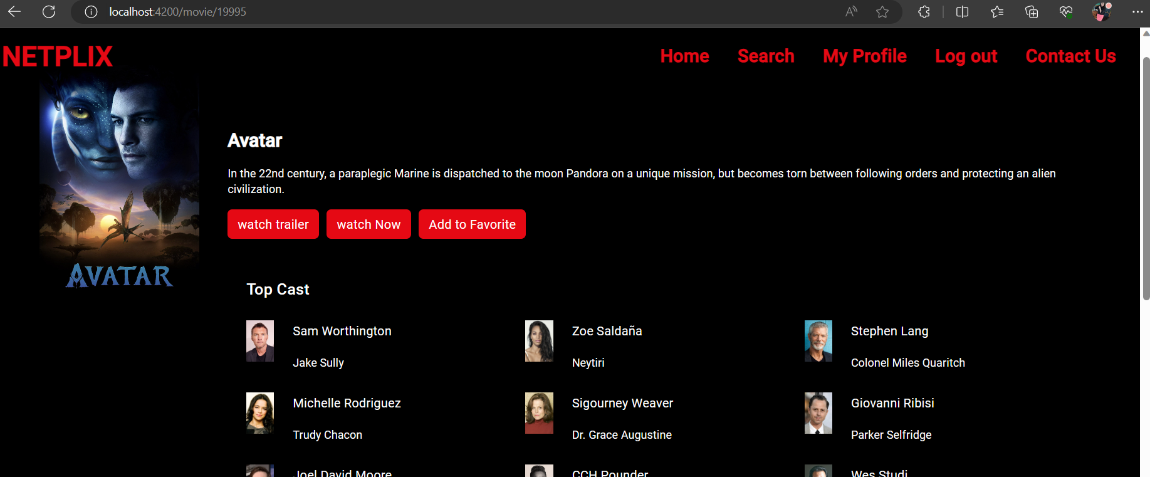
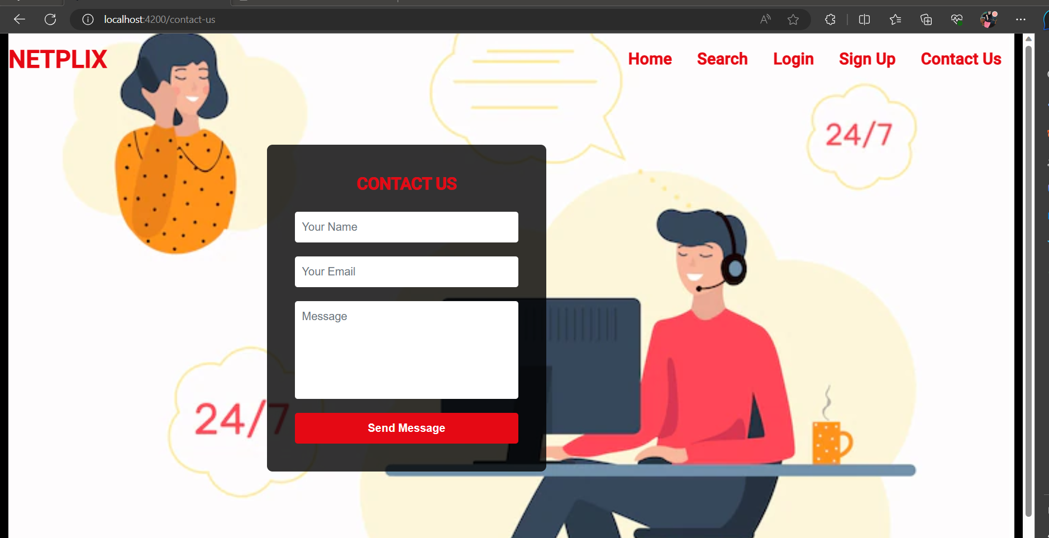
CONATCT US PAGE
USER PAGE

Slide 13
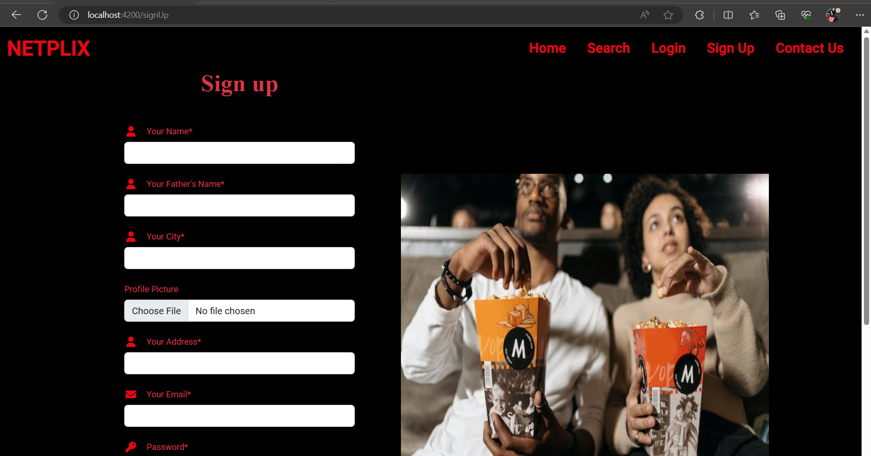
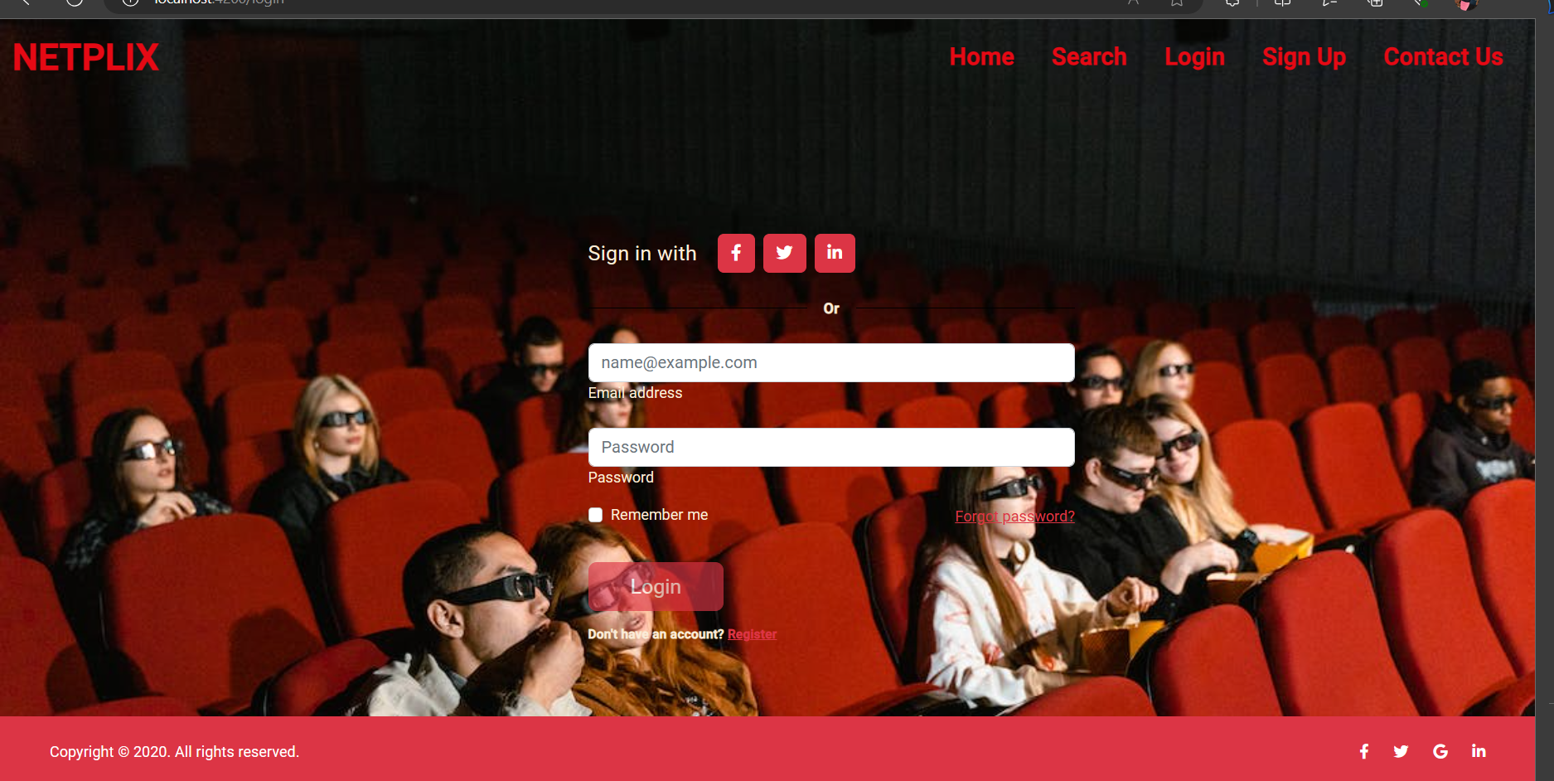
SIGNUP PAGE
LOGIN PAGE

Slide 14
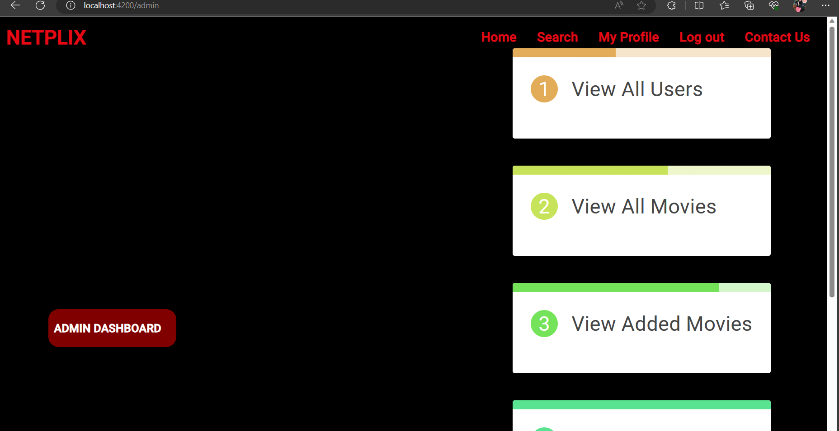
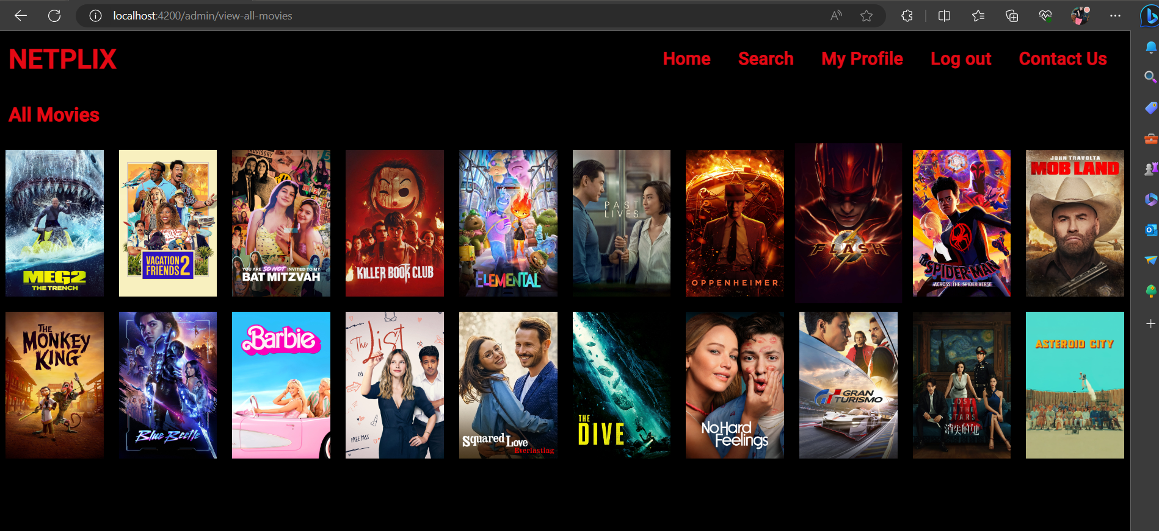
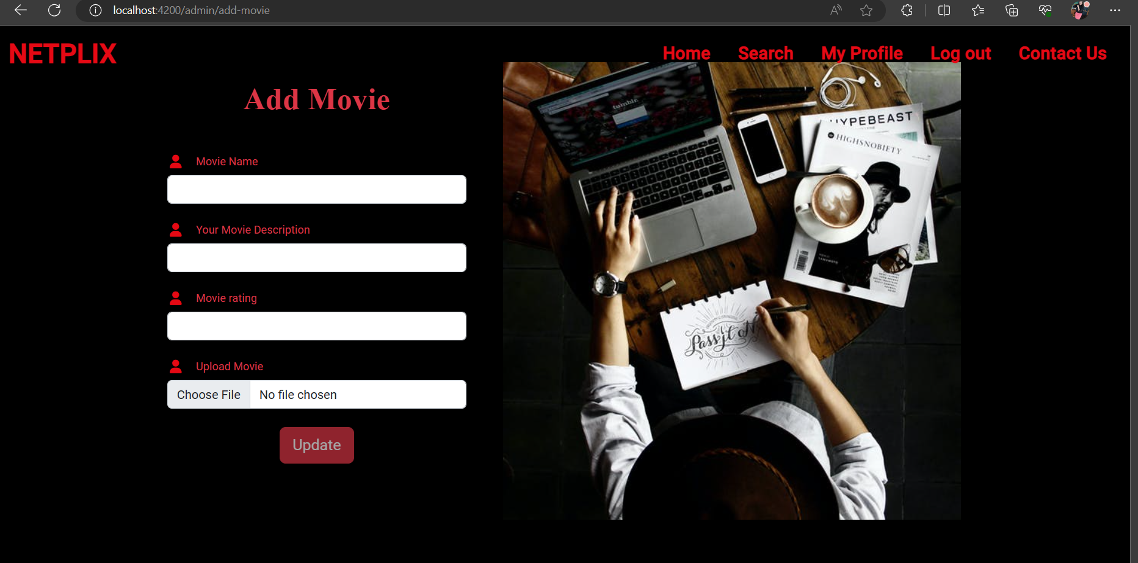
ADMIN PAGE

Slide 15



FUTURE ENHANCEMENT
Paid subscription
&
Payment gateway
ABLE TO MANAGE
USERS
BY ADMIN
M O R E U S E R
F R I E N D L Y F E A T U R E S

Slide 16
THANKYOU

